Slide 1
Wiener Screener
By: Team <Insert Team Name Here>

Slide 2

Introduction
This project is based on the show Silicon Valley
In the show, Erlich Bachman operates an incubator for individuals attempting to start their revolutionary tech company
Jian Yang is one of the members of Erlich’s incubator, but has abused California’s tenants laws to live rent free
After months of “work,” Jian Yang finally presents his work to the team and it is a complete failure
Lastly, at the end of this presentation, we will have a QR code to download the application

Slide 3
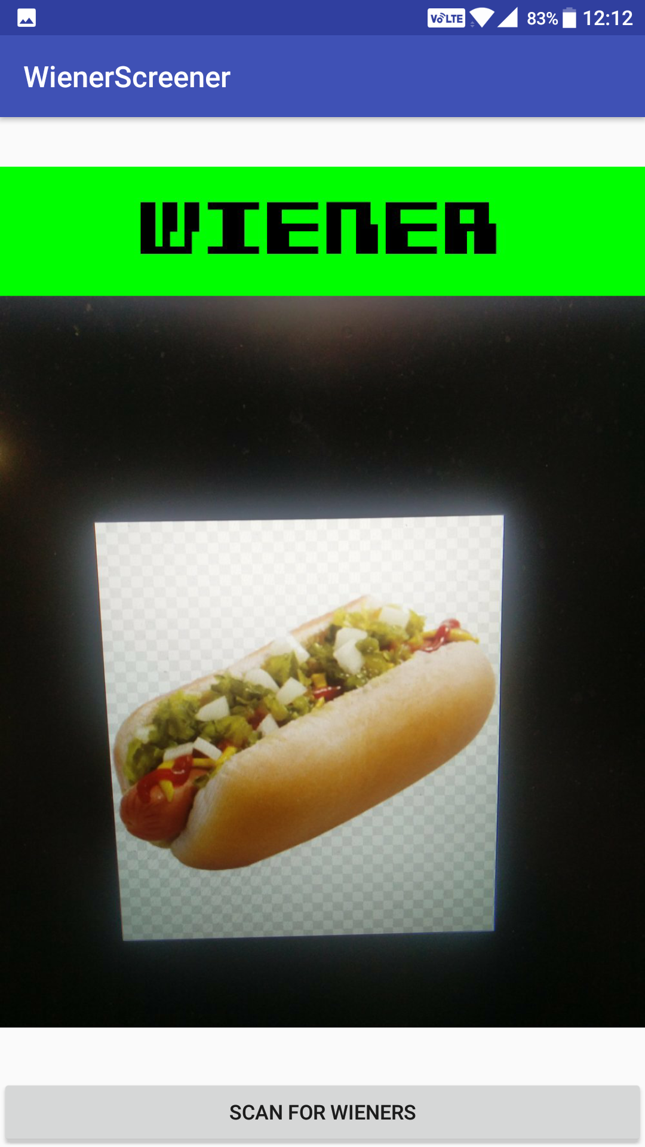
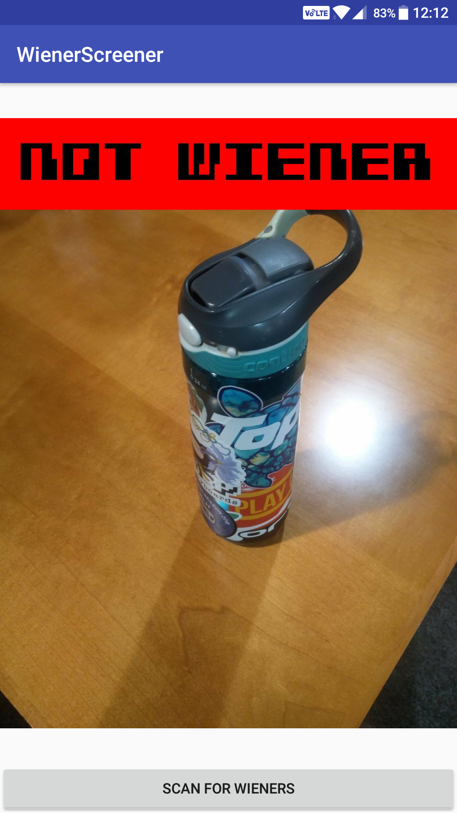
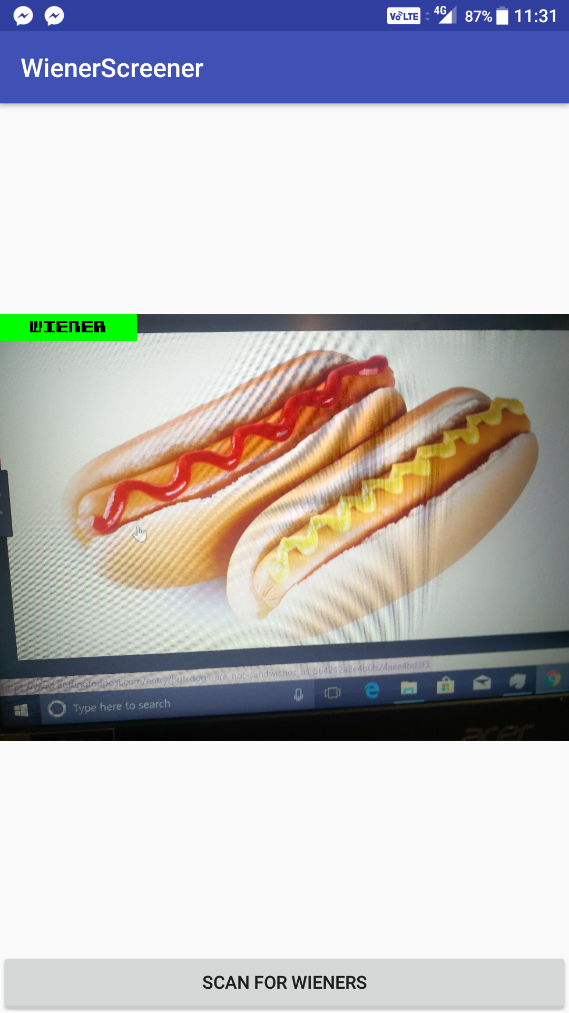
What is the “Wiener Screener”?
Using machine learning, we were able to develop an android
application that determines if the picture taken is of a wiener.

Slide 4
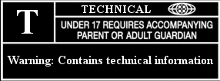
Warning! The next few slides contain technical information!

Slide 5

Technical 1: The Neural Network
Application is based off the concept of machine learning
Massive amounts of images were used to train our convolutional neural network
TensorFlow and Python were the foundation that allowed us to “teach” our application to successfully identify hot dogs.

Slide 6

Technical 2: The Android Application
Java was used to create a user-friendly Android application with Android Studio
The application takes a picture that will be analyzed by the neural network to be classified as wiener/not wiener
To accomplish this, access to the network’s training data is necessary

Slide 7
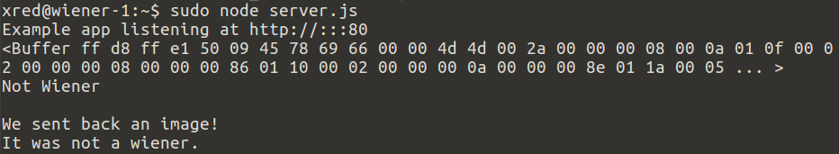
Technical 3: Client-Server Communication
A web server was created to handle user requests
Data transferred securely over HTTPS
Node.js responds to HTTP requests
Docker processes submitted images with our neural network
ImageMagick formats the end result
Google Cloud Platform
Utilized free $50 credit obtained from workshop to host a VM in the Compute Engine

Slide 8

Now for the aaaaaaaaaaaaaaaaaaaaaaaaaaaaaaaaaaaaaaaaaa demonstration

Slide 9
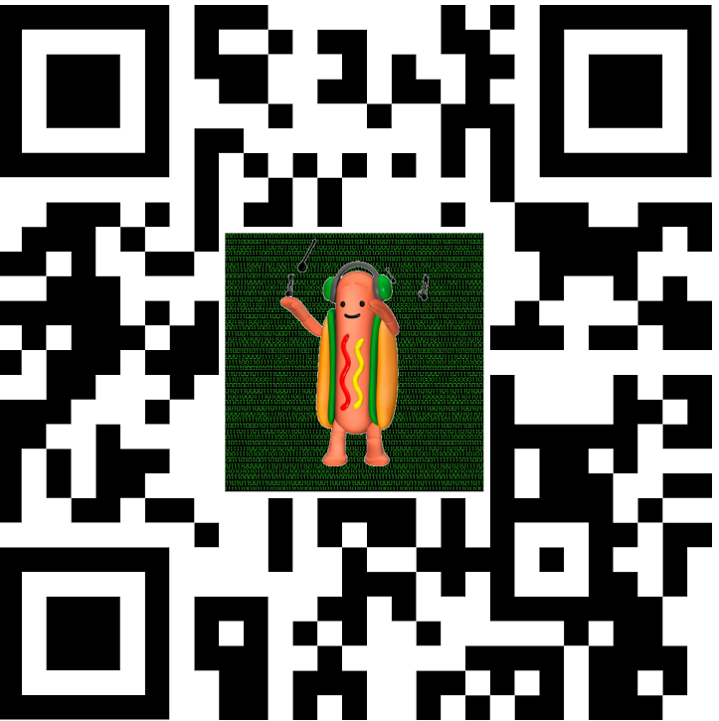
QR Code
Visit https://wiener.world/download
https://github.com/richardred/WienerScreener

